Slide 1

GRAPH THEORY AND ITS APPLICATIONS
Dr. Arti Arya
Department of Computer Science & Engineering

Slide 2

Graph Theory and its Applications Disclaimer
The slides are prepared by Dr. Surabhi Narayan and a lot of content is added by Dr. Arti Arya. The sources of the information other than text book is mentioned wherever used.

Slide 3
GRAPH THEORY AND ITS APPLICATIONS
EULERIAN GRAPHS
Dr. Arti Arya
Department of Computer Science & Engineering

Slide 4
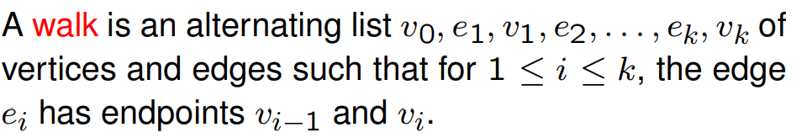
Graph Theory and its Applications Walk, Path, circuits
Walk
A walk in the graph G=(V,E) is a finite sequence of the form
v_{i0}, e_{j1}, v_{i1}, e_{j2}, ……. e_{jk}, v_{ik}
v₂
e₂
v₃
e₁
v₁
e₈
e₇
e₃
e₅
^{e}10
e
9
v₅
e₆
v₄
e₄
v₆

Slide 5
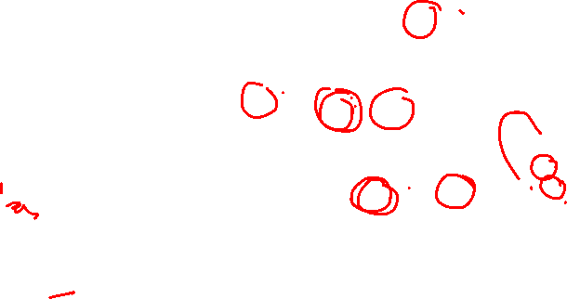
Graph Theory and its Applications Walk, Path, circuits
Walk
v₂
e₂
v₃
e₁
v₁
e₈
e₇
e₃
e₅
^{e}10
e
9
v₅
e₆
v₄
e₄
v₆
v₂e₇v₅e₈v₁e₈v₅e₆v₄e₅v₄ is an open walk
v_{i0} and v_{ik} are the end vertices.
v_{i0} is the initial vertex and v_{ik} is the terminal vertex K is the length of the walk

Slide 6
Graph Theory and its Applications Walk, Path, circuits
Walk
v₂
e₂
v₃
e₁
v₁
e₈
e₇
e₃
e₅
^{e}10
e
9
v₅
e₆
v₄
e₄
v₆
v₂e₇v₅e₈v₁e₈v₅e₆v₄e₅v₄ is an open walk whereas v₄e₅v₄e₃v₃e₂v₂e₇v₅e₆v₄ is a closed walk

Slide 7

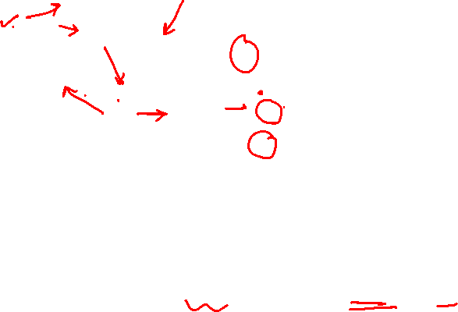
Graph Theory and its Applications Walk, Path, circuits
Trail
v₂
e₂
v₃
e₁
v₁
e₈
e₇
e₃
e₅
^{e}10
e
9
v₅
e₆
v₄
e₄
v₆
A walk is a trail if edges of the walk are traversed at most once
v₁e₈v₅e₉v₁e₁v₂e₇v₅e₆v₄e₅v₄e₄v₄ is a trail.

Slide 8

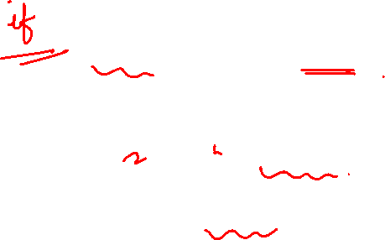
Graph Theory and its Applications Walk, Path, circuits
Path
v₂
e₂
v₃
e₁
v₁
e₈
e₇
e₃
e₅
^{e}10
e
9
v₅
e₆
v₄
e₄
v₆
A trail is a path wherein vertices are visited at most once.
v₂e₇v₅e₆v₄e₃v₃ is a path.
A closed trail is a circuit whereas a closed path is a cycle. v₅e₇v₂e₂v₃e₃v₄e₄v₄e₆v₅ is a circuit
whereas
v₅e₇v₂e₂v₃e₃v₄e₆v₅ is a cycle

Slide 9
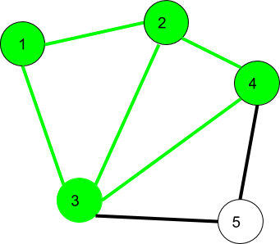
Graph Theory and its Applications Walk, Path, circuits
Walk
$$1→2→3→4→2→1→3 is a walk$$

Slide 10

Graph Theory and its Applications Walk, Path, circuits
Walk
$$1→2→3→4→2→1→3 is an open walk$$
$$1→3→2→4→3→2→1 is a closed walk$$

Slide 11
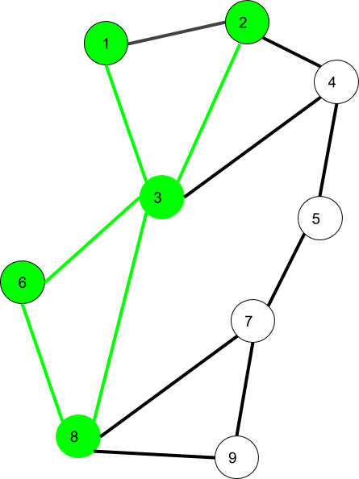
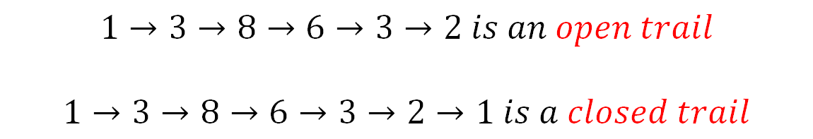
Graph Theory and its Applications Walk, Path, circuits
Trail
$$1→3→8→6→3→2 is an open trail$$
$$1→3→8→6→3→2→1 is a closed trail$$

Slide 12
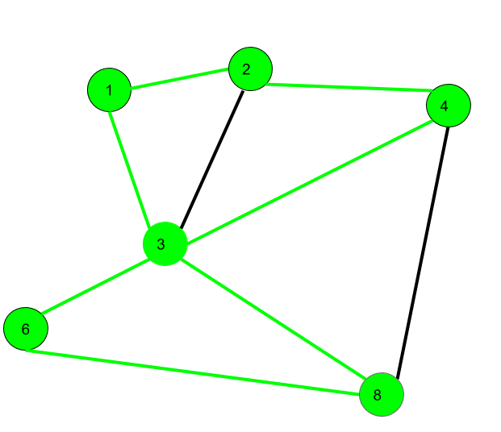
Graph Theory and its Applications Walk, Path, circuits
Path, Circuit and Cycle
$$1→2→4→3→8→6 is a path$$
$$1→2→4→3→8→6→3→1 is a circuit$$
$1→2→4→8→6→3→1$ is a cycle
https://www.geeksforgeeks.org/mathematics-walks-trails-paths-cycles-and-circuits-in-graph/

Slide 13
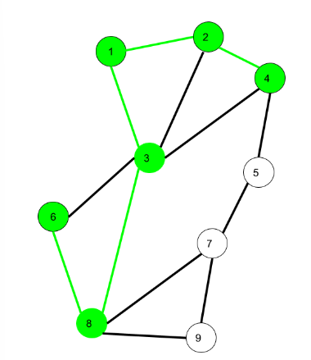
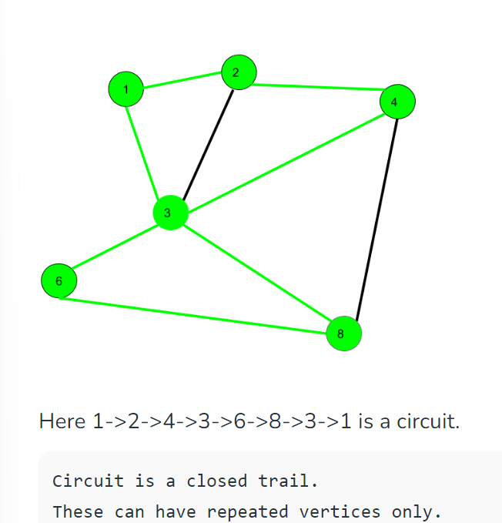
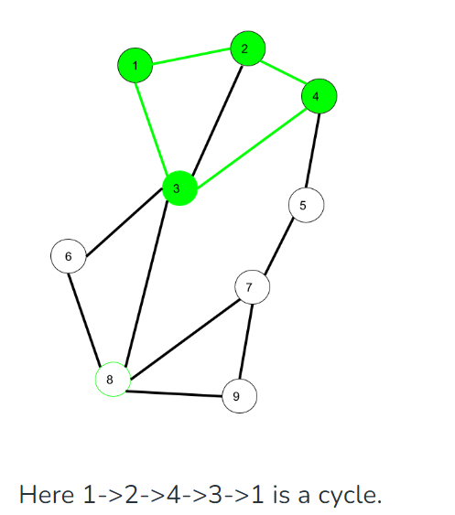
Graph Theory and its Applications Walk, Path, circuits
Path, Circuit and Cycle
Here 6->8->3->1->2->4 is a Path (
Vertex and Edge not repeated)
https://www.geeksforgeeks.org/mathematics-walks-trails-paths-cycles-and-circuits-in-graph/

Slide 14
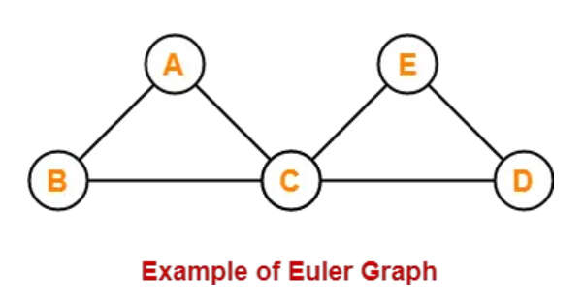


Graph Theory and its Applications Walk, Path, circuits
Eulerian Graph
Euler Graph - A connected graph G is called a Euler graph, if there is a closed trail which includes every edge of the graph G.
The above graph contains an Euler circuit BACEDCB, so it is an Euler graph

Slide 15
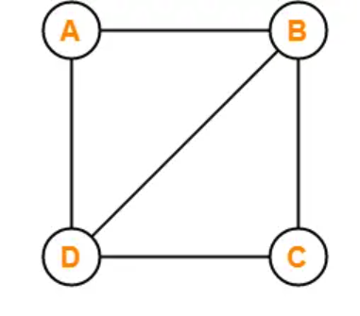
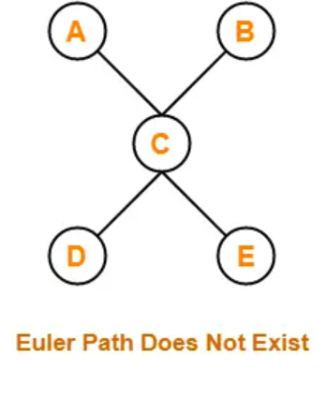

Graph Theory and its Applications Walk, Path, circuits
Eulerian Graph
Euler Path (Euler path is also known as Euler Trail or Euler Walk). - A Euler path is a path that uses every edge of a graph exactly once. A Euler path starts and ends at different vertices.

Slide 16
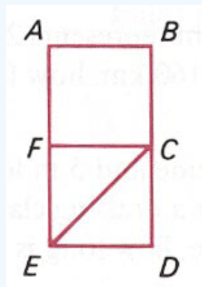
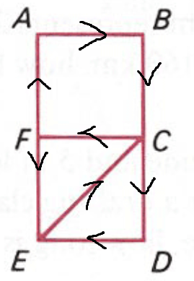
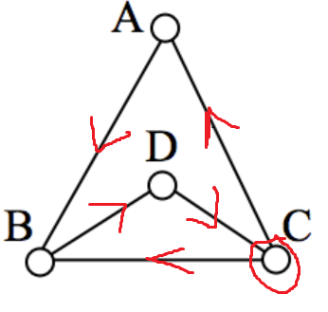
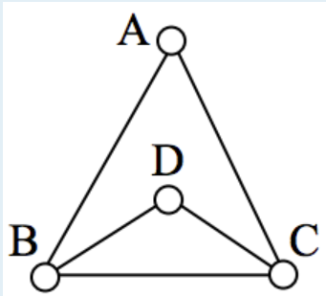
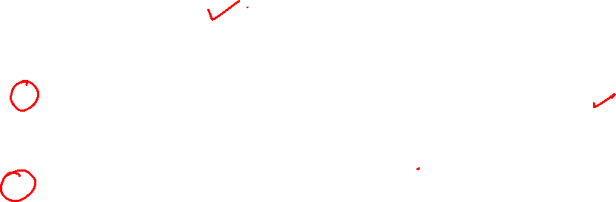
Graph Theory and its Applications Walk, Path, circuits
Eulerian Graph
Euler Path (Euler path is also known as Euler Trail or Euler Walk). - A Euler path is a path that uses every edge of a graph exactly once. A Euler path starts and ends at different vertices.

Slide 17
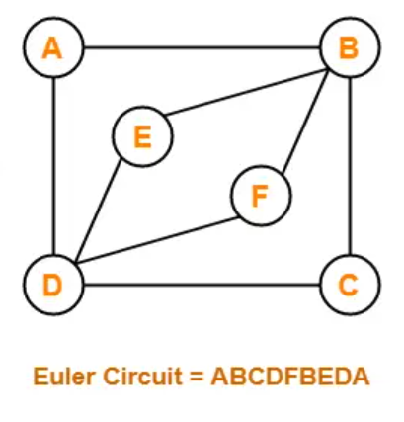
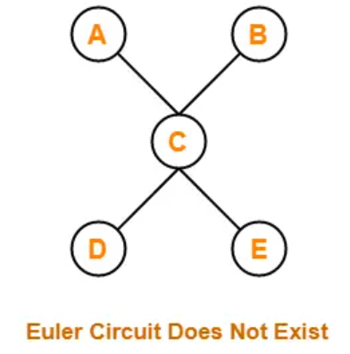
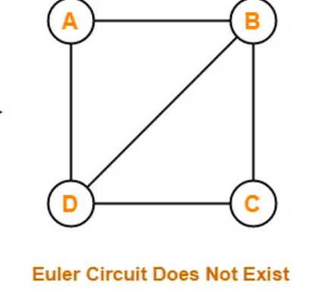
Graph Theory and its Applications Walk, Path, circuits
Euler Circuit - A Euler circuit is a circuit that uses every edge of a graph exactly once. (Eulerian circuit is a Eulerian path which starts and ends on the same vertex.)
A Euler circuit always starts and ends at the same vertex.
A connected graph G is a Euler graph iff all vertices of G are of even degree, and a connected graph G is Eulerian iff its edge set can be decomposed into cycles.

Slide 18
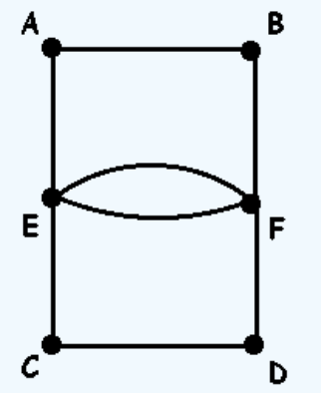
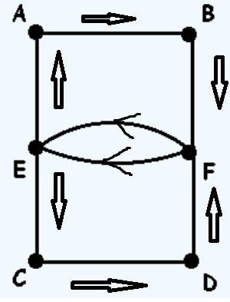
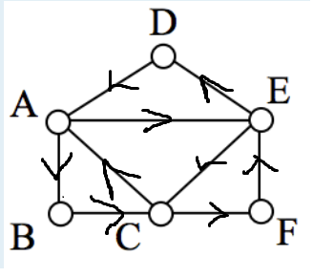
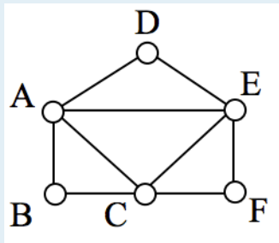
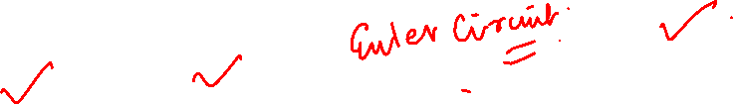
Graph Theory and its Applications Walk, Path, circuits
Euler Circuit - A Euler circuit is a circuit that uses every edge of a graph exactly once.
A Euler circuit always starts and ends at the same vertex.
A connected graph G is a Euler graph iff all vertices of G are of even degree, and a connected graph G is Eulerian iff its edge set can be decomposed into cycles.

Slide 19
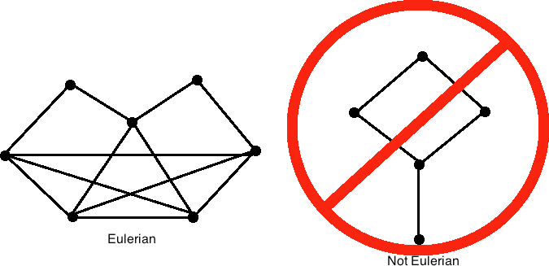
Graph Theory and its Applications Walk, Path, circuits
7
8
9
10
1
2
4
3
5
6
11
12
http://mathonline.wikidot.com/eulerian-graphs-and-semi-eulerian-graphs

Slide 20
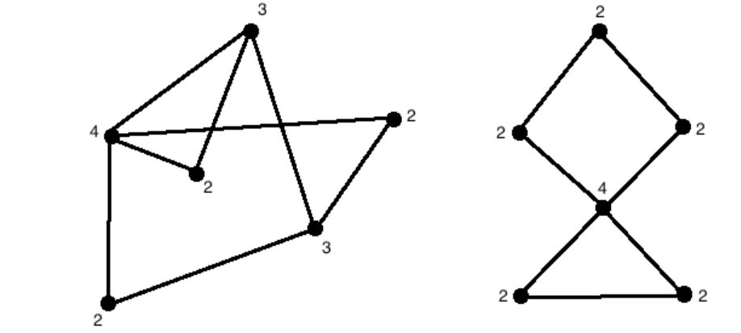
Graph Theory and its Applications Walk, Path, circuits
Whether Eulerian or not?
Not Eulerian as there are two vertices with odd degree,
Eulerian since each vertex has an even degree.
http://mathonline.wikidot.com/eulerian-graphs-and-semi-eulerian-graphs

Slide 21
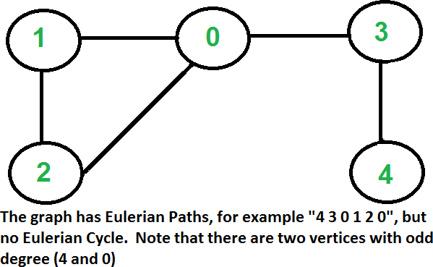
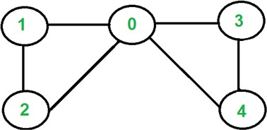

Graph Theory and its Applications Walk, Path, circuits
The graph has Euler circuit but not Euler cycle. Note that all vertices are of even degree
A graph is called Eulerian if it has a Eulerian Circuit and called Semi-Eulerian if it has a Eulerian Path.

Slide 22
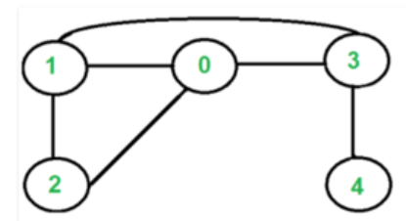
Graph Theory and its Applications Walk, Path, circuits
Not Eulerian bcoz there are 4 vertices with odd degree.
A graph is called Eulerian if it has a Eulerian Circuit and called Semi-Eulerian if it has a Eulerian Path.

Slide 23
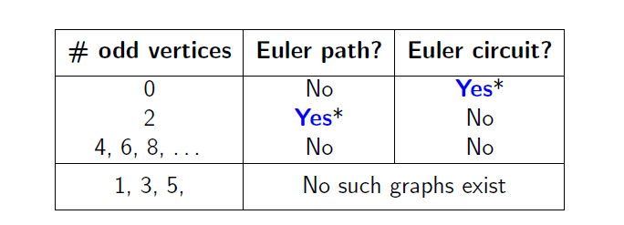
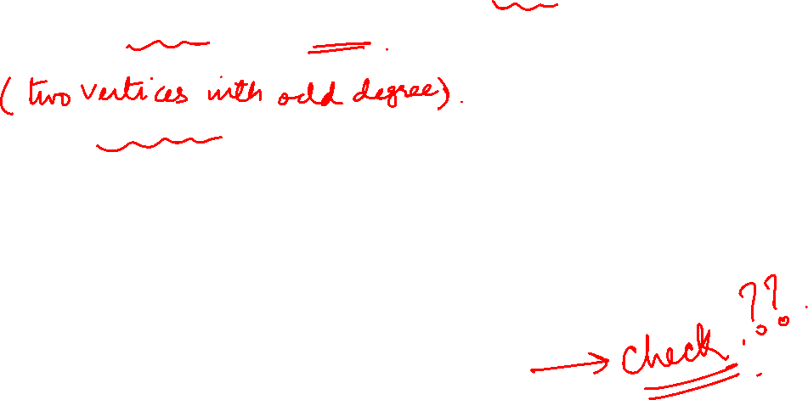
Graph Theory and its Applications Walk, Path, circuits
Is it possible to determine whether a graph has an Euler path or an Euler circuit, without necessarily having to find one explicitly?
If a graph G has an Euler path, then it must have exactly two odd vertices.
If a graph G has an Euler circuit, then all of its vertices must be even vertices.

Slide 24
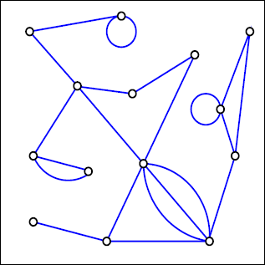
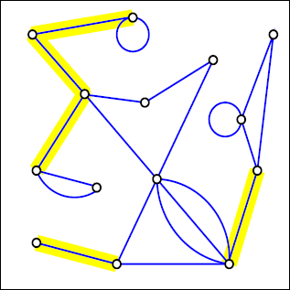
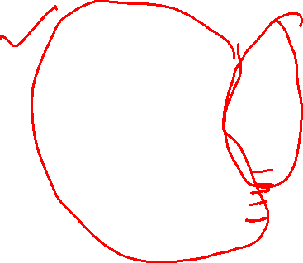
Graph Theory and its Applications Bridges
Bridges
Removing a single edge from a connected graph can make it disconnected. Such an edge is called a bridge.

Slide 25
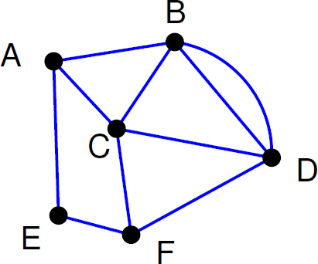
Graph Theory and its Applications Walk, Path, circuits
Find an Euler path in the graph below.
There are two odd vertices, A and F.
Let’s start at F.

Slide 26
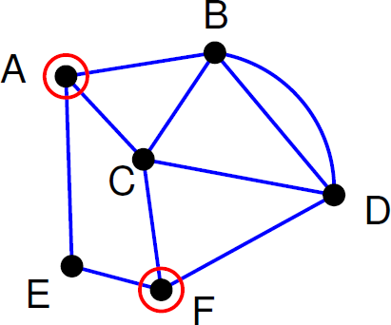
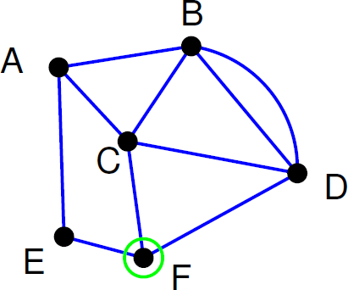
Graph Theory and its Applications Walk, Path, circuits
Start walking at F.
When an edge is traversed, delete it.

Slide 27
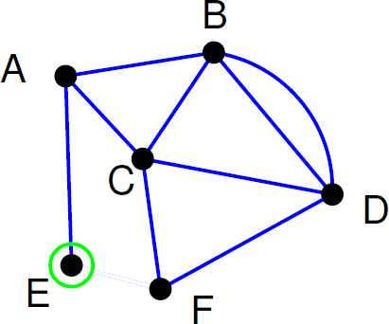
Graph Theory and its Applications Walk, Path, circuits
Path so far: FE

Slide 28
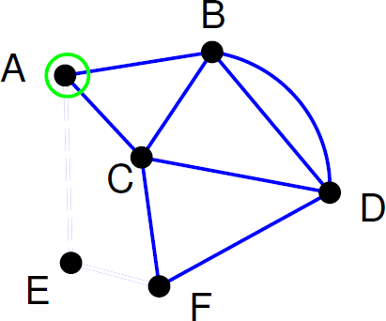
Graph Theory and its Applications Walk, Path, circuits
Path so far: FEA

Slide 29
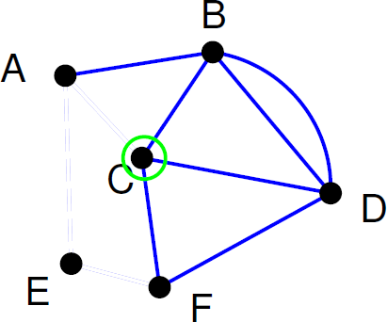
Graph Theory and its Applications Walk, Path, circuits
Path so far: FEAC

Slide 30
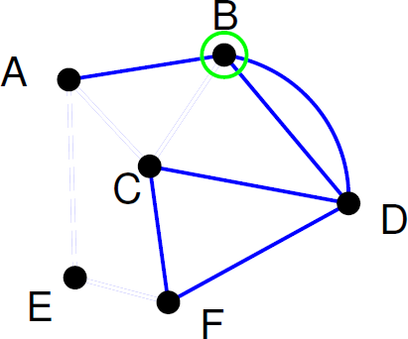
Graph Theory and its Applications Walk, Path, circuits
Path so far: FEACB

Slide 31

Graph Theory and its Applications Walk, Path, circuits
Path so far: FEACB
Crossing the edge BA would be a mistake, because we would be stuck there. The reason is that BA is a bridge. Cross a bridge only if it is the only edge available

Slide 32
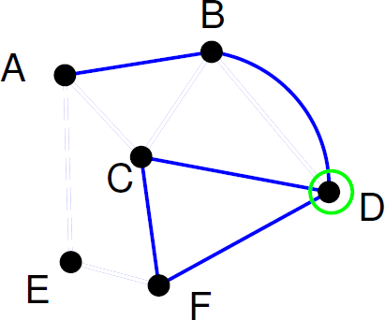
Graph Theory and its Applications Walk, Path, circuits
Path so far: FEACBD

Slide 33
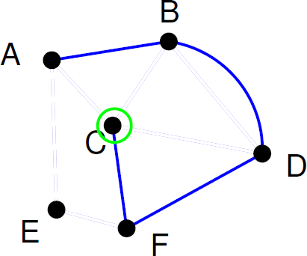
Graph Theory and its Applications Walk, Path, circuits
Path so far: FEACBDC

Slide 34
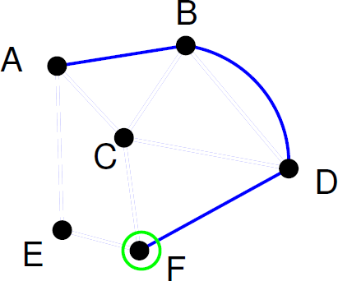
Graph Theory and its Applications Walk, Path, circuits
Path so far: FEACBDCF

Slide 35
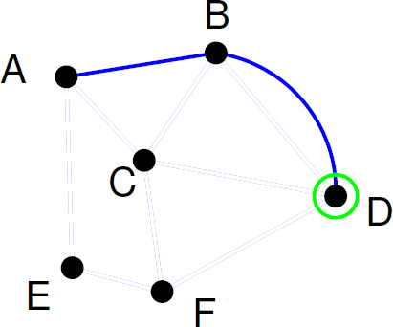
Graph Theory and its Applications Walk, Path, circuits
Path so far: FEACBDCFD

Slide 36
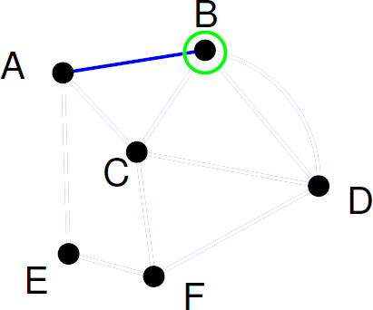
Graph Theory and its Applications Walk, Path, circuits
Path so far: FEACBDCFDB

Slide 37
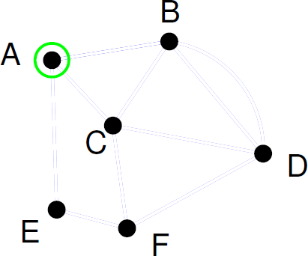
Graph Theory and its Applications Walk, Path, circuits
Path so far: FEACBDCFDBA
Euler Path: F E A C B D C F D B A

Slide 38

Graph Theory and its Applications Walk, Path, circuits
Formally, a graph is Eulerian iff the following conditions are met:
The graph is connected.
Every vertex in the graph has an even degree (even number of edges incident to it).
If these conditions are satisfied, the graph has an Eulerian circuit, and it is an Eulerian graph.

Slide 39

Graph Theory and its Applications Walk, Path, circuits
Fleury’s Algorithm
Fleury's algorithm, (Eulerian path/circuit algorithm), is a graph traversal algorithm used to find Eulerian paths or circuits in a graph.

Slide 40

Graph Theory and its Applications Walk, Path, circuits
Fleury’s Algorithm
The graph must have either 0 or 2 odd vertices.
If there are 0 odd vertices, start anywhere. If there are 2 odd vertices, start at one of them.
Follow edges one at a time. If you have a choice between a bridge and a
non-bridge, always choose the non-bridge.
Stop when you run out of edges.

Slide 41


Graph Theory and its Applications Fluery’s Algorithm
Let us start the tour from vertex ‘2’.
There are two vertices with odd degrees, ‘2’ and ‘3’, and we can start paths from any of them.

Slide 42


Graph Theory and its Applications Fluery’s Algorithm
Three edges are going out from vertex ‘2’.
Let’s not pick the edge ‘2-3’ because that is a bridge. Let’s pick any of the remaining two edges.
Let us say we pick ‘2-0’. We remove this edge and move to vertex ‘0’.

Slide 43

Graph Theory and its Applications Fluery’s Algorithm
There is only one edge from vertex ‘0’, so we pick it, remove it and move to vertex ‘1’.
There is only one edge from vertex ‘1’, so we pick it, remove it and move to vertex ‘2’. Euler tour becomes ‘2-0 0-1 1-2’

Slide 44


Graph Theory and its Applications Fluery’s Algorithm
Again, there is only one edge from vertex 2, so we pick it, remove it and move to vertex 3. Euler tour becomes ‘2-0-1-2-3’
There are no more edges left, so we stop here. Final tour is ‘2-0-1-2-3’. ( Thus there is a Euler’s path 2-0-1-2-3)

Slide 45

Graph Theory and its Applications Walk, Path, circuits
Is the graph Eulerian?
f
a
b
g
d
c
h
e
Since all the vertices are having even degree and graph is connected, so graph is Euler graph.
Also, there exist a closed trail or Euler Circuit
$$f→a→b→g→c→h→b→c→d→a→e→d→f$$

Slide 46

Graph Theory and its Applications Walk, Path, circuits
Is the graph Eulerian?
Let’s Find a Euler Circuit!!

Slide 47
Graph Theory and its Applications Walk, Path, circuits
Is the graph Eulerian?

Slide 48
Graph Theory and its Applications Walk, Path, circuits
Is the graph Eulerian?

Slide 49
Graph Theory and its Applications Walk, Path, circuits
Is the graph Eulerian?

Slide 50
Graph Theory and its Applications Walk, Path, circuits
Is the graph Eulerian?

Slide 51
Graph Theory and its Applications Walk, Path, circuits
Is the graph Eulerian?

Slide 52
Graph Theory and its Applications Walk, Path, circuits
Is the graph Eulerian?

Slide 53
Graph Theory and its Applications Walk, Path, circuits
Is the graph Eulerian?

Slide 54
Graph Theory and its Applications Walk, Path, circuits
Is the graph Eulerian?

Slide 55
Graph Theory and its Applications Walk, Path, circuits
Is the graph Eulerian?

Slide 56
Graph Theory and its Applications Walk, Path, circuits
Is the graph Eulerian?

Slide 57
Graph Theory and its Applications Walk, Path, circuits
Is the graph Eulerian?

Slide 58
Graph Theory and its Applications Walk, Path, circuits
Is the graph Eulerian?

Slide 59
Graph Theory and its Applications Walk, Path, circuits
Is the graph Eulerian?

Slide 60
Graph Theory and its Applications Walk, Path, circuits
Is the graph Eulerian?

Slide 61
Graph Theory and its Applications Walk, Path, circuits
Is the graph Eulerian?

Slide 62
Graph Theory and its Applications Walk, Path, circuits
Is the graph Eulerian?

Slide 63
Graph Theory and its Applications Walk, Path, circuits
Is the graph Eulerian?

Slide 64
Graph Theory and its Applications Walk, Path, circuits
Is the graph Eulerian?

Slide 65
Graph Theory and its Applications Walk, Path, circuits
Is the graph Eulerian?

Slide 66
Graph Theory and its Applications Walk, Path, circuits
Is the graph Eulerian?

Slide 67
Graph Theory and its Applications Walk, Path, circuits
Is the graph Eulerian?

Slide 68
Graph Theory and its Applications Walk, Path, circuits
Is the graph Eulerian?

Slide 69
Graph Theory and its Applications Walk, Path, circuits
Is the graph Eulerian?

Slide 70
Graph Theory and its Applications Walk, Path, circuits
Is the graph Eulerian?

Slide 71
Graph Theory and its Applications Walk, Path, circuits
Is the graph Eulerian?

Slide 72
Graph Theory and its Applications Walk, Path, circuits
Is the graph Eulerian?

Slide 73
Graph Theory and its Applications Walk, Path, circuits
Is the graph Eulerian?

Slide 74
Graph Theory and its Applications Walk, Path, circuits
Is the graph Eulerian?

Slide 75

Graph Theory and its Applications Walk, Path, circuits
Theorem : A connected graph G is a Euler graph iff all vertices of G are of even degree.

Slide 76

Graph Theory and its Applications Walk, Path, circuits

Slide 77

Graph Theory and its Applications Walk, Path, circuits

Slide 78



Slide 79


Slide 80


Graph Theory and its Applications Walk, Path, circuits
Euler Circuit in Directed Graphs
A directed graph has an Eulerian cycle or Eulerian circuit if following conditions are true:
All vertices with nonzero degree belong to a single strongly connected component.
In-degree = out-degree for every vertex.
Next is Hierholzer's algorithm for finding an Eulerian circuit
https://www.geeksforgeeks.org/euler-circuit-directed-graph/

Slide 81





Graph Theory and its Applications Walk, Path, circuits
Heirholzer’s Algorithm
0—1—2– 0

Slide 82

Graph Theory and its Applications Walk, Path, circuits
Heirholzer’s Algorithm
0—1—2—0
1—3—4—1
Combine the two 0—1—(3—4—1)—2—0

Slide 83

Graph Theory and its Applications Walk, Path, circuits
Heirholzer’s Algorithm
a
a—b—c—a
b—d—c—e—d—b
Combine the two circuits
a—b—d—c—e—d—b—c—a
b
c
a—b—c—a
c—e—d—c
b—d—b
Combine the three circuits
a—b—d—b—c—e—d—c—a
d
e

Slide 84


Graph Theory and its Applications Walk, Path, circuits
Heirholzer’s Algorithm
1-2-3-4-5-6-1
6-7-2-6
On combining them, we get 1-2-3-4-5-(6-7-2-6)-1

Slide 85

Graph Theory and its Applications Walk, Path, circuits
Heirholzer’s Algorithm

Slide 86
Graph Theory and its Applications
How Hierholzer’s algorithm works?
Find a closed tour in a graph.
Start from any vertex v and follow a trail of edges until returning to v. The tour formed a closed tour.
2. Find branches
If there is a vertex u that belongs to the current tour, but that has adjacent edges not part of the tour, start another trail from u, following unused edges until returning to u.
3. Use backtrack to use all edges
Keep following unused edges and removing them when we get stuck. When stuck, backtrack to the nearest vertex in the current path that has unused edges. Repeat the process until all the edges have been used.
https://www.lavivienpost.com/hierholzers-algorithm-find-euler-path/

Slide 87

Graph Theory and its Applications Walk, Path, circuits
Heirholzer’s Algorithm

Slide 88




Graph Theory and its Applications Walk, Path, circuits
Heirholzer’s Algorithm
a _{a}
b
c
d
e
f
g
h
i
j
k

Slide 89

Graph Theory and its Applications Walk, Path, circuits
Heirholzer’s Algorithm

Slide 90

Graph Theory and its Applications Walk, Path, circuits
Which of the following graphs contain an Euler Trail/path? Which contain an Euler circuit?
For a graph to have an Euler circuit, all vertices must have even degree.
The converse is also true: if all the vertices of a graph have even degree, then the graph has an Euler circuit,
If there are exactly two vertices with odd degree, the graph has an Euler path.
K4 K5 K5,7 K2,7
C7 P7
Ans: K4 does not have an Euler path or circuit. K5 has an Euler circuit, but not a Euler path.
K5,7 does not have an Euler path or circuit. K2,7 has an Euler path but not a Euler circuit.(If there are exactly two vertices with odd degree, the graph has an Euler path)
C7 has an Euler circuit (it is a circuit graph!) P7 has an Euler path but not a Euler circuit

Slide 91

Graph Theory and its Applications Questions
For what value of n does the graph K_{n} has an Euler Circuit?
K_{n} has a Eulerian circuit if the degree of each vertex is even.
This means n has to be odd since degree of each vertex in K_{n}=n-1

Slide 92


Graph Theory and its Applications Walk, Path, circuits
For what values of m and n does the graph K_{m,n} contain a Euler path and a Euler circuit?

Slide 93
Graph Theory and its Applications Walk, Path, circuits
For what values of m and n does the graph K_{m,n} contain a Euler path and an Euler circuit?
Q: Can Euler graph contain isolated vertices?
Ans: YES ( A Euler graph is a connected graph except for any isolated vertices the graph may have.)

Slide 94





Graph Theory and its Applications Walk, Path, circuits
A bridge builder has come to Königsberg and would like to add bridges so that it is possible to travel over every bridge exactly once. How many bridges must be built?
If we build one bridge, we can have an Euler path. Two bridges must be built for an Euler circuit.

Slide 95
THANK YOU
Dr. Arti Arya
Department of Computer Science &Engineering
artiarya@pes.edu

